Slide 1

EatFit: AI Based Smart Food Health Compatibility Checker
Sakshi Kadam - 22107032
Priyanka Barman - 22107004
Tejas Deshmukh - 22107015
KisanKumar Jena - 22107049
Project Guide
Dr. Veena Trivedi

Slide 2
Outline
Introduction
Literature Survey of the existing systems
Limitations of the existing systems
Problem statement
System Design
Technologies and methodologies
Implementation
Conclusion
References

Slide 3
Introduction
EatFit is an AI-powered that helps you make healthier choices by instantly analyzing ingredients with a simple uploading an images of packed food products.
It identifies harmful additives, allergens, and dietary concerns, ensuring your food is safe while also checking for age restrictions and health risks.
If a product isn’t suitable, EatFit recommends a better alternative, making it easy to switch to a healthier option without any guesswork.
Designed for effortless decision-making, acts as your personal nutrition expert, simplifying shopping and promoting a smarter, healthier lifestyle.

Slide 4
Introduction
1.1 MOTIVATION :
With the increasing complexity of food products and the nutrition list consumers face significant challenges in making healthy dietary choices.
Many food products contain allergens and harmful additives. Identifying these risks ensures safer consumption.
In today’s fast-paced world, manually researching the safety and compatibility of each product is impractical.
An AI-powered system simplifies this by providing instant insights and alternatives.

Slide 5
Introduction
1.2 Objectives :
Nutrient Analysis & Rating: Extract and analyze product nutrients using OCR and rate them based on user health conditions.
Alternative Product Recommendation: Use Open Food Facts API to suggest healthier alternatives and in that process, also check for allergens.
Healthy-Diet Guidance System: Recommend suitable food based on user activity level and dietary preferences using Random Forest.
Cart & Admin Integration: Allow users to select, purchase products, and manage alternatives via an admin panel.

Slide 6
Literature Survey of the existing system
Sr No | Title | Author | Year | Outcomes | Methodology | Result
1 | [1] Leveraging AI in Food Safety, Quality, and Security | Sambandh Bhusan Dhal, Debashish Kar | 11 Jan 2025 | AI improves food safety, quality (including packed products), and security by detecting contamination, enhancing consistency, and optimizing supply chains. | Literature review of AI applications in food systems from 1990 to 2024. Analyzed machine learning, computer vision, deep learning, and emerging technologies like IoT and blockchain. | Identified AI’s critical role in food systems, providing solutions for food safety, quality, and security. Highlighted challenges like data limitations and ethical concerns, and proposed future research.

Slide 7
Literature Survey of the existing system
Sr No. | Title | Author | Year | Outcomes | Methodology | Result
2 | [2] Nutritional Intelligence in the Food System: Combining Food, Health | Danielle I. McCarth | 27 Nov 2024 | The study explores the role of AI in improving food system decision-making, focusing on nutrition, health, and data-driven approaches. | The methodology involves collecting large-scale food consumption data, integrating it with health records, and applying AI models to predict nutritional outcomes. | The results show that AI-powered nutritional intelligence significantly improves dietary decision-making, leading to better health outcomes. The study also highlights the potential of AI in shaping future food policies and healthcare interventions.

Slide 8
Literature Survey of the existing system
Sr No. | Title | Author | Year | Outcomes | Methodology | Result
3 | [3] NLP and Machine Learning for Food Categories Nutrition Prediction | Guanlan, Mavra Ahmed, Mary R. L'Abbé | 15 March 2023 | NLP and ML automate food categorization and nutrition prediction, enhancing accuracy and reducing manual efforts. | BERT-based NLP model for text processing; ML algorithms (Random Forest , k-NN, Elastic Net) for food classification and nutrition estimation. | High accuracy: 0.98 (major categories), 0.96 (subcategories), R² = 0.87 for nutrition prediction.

Slide 9
Limitations of existing systems
Many food product reviewers provide general nutritional information but fail to account for individual health conditions..
Most systems do not highlight potential allergens or sensitivities (e.g., spice intolerance, dairy allergies).
Existing AI models may struggle with food product packaging variations and unclear images.
A perfect model would require deeper integration with medical records and real-time health tracking, which is currently limited due to privacy and data-sharing constraints.
There are extensive databases available of nutritional information but personalized health integration is sill a challenge.

Slide 10
Problem statement
People often struggle to find information about food based on health conditions, allergies and activity level.
Many products contain hidden allergens or harmful additives, but there’s no easy way for users to identify them.
Finding foods that align with personal health conditions and dietary needs is difficult without proper guidance.
Consumers often struggle to decode ingredient lists, making it challenging to choose healthier food options.

Slide 11
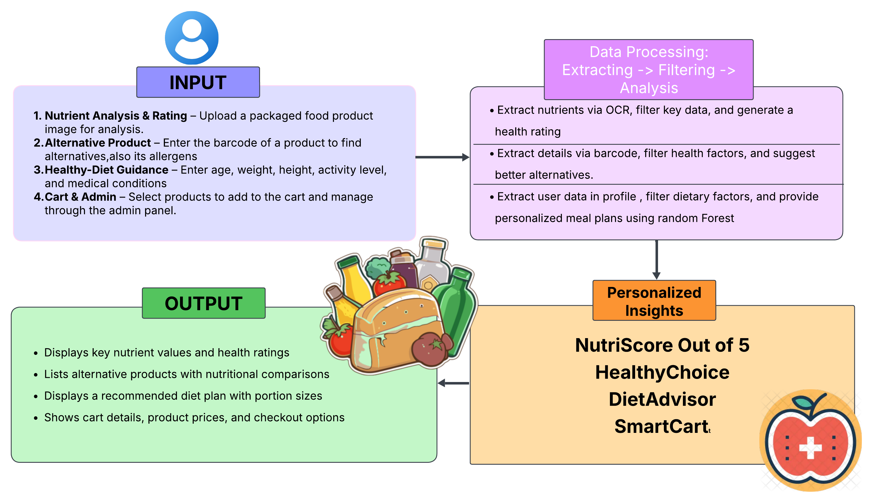
System Design

Slide 12
Technologies and methodologies
Front-End : Back-End
1. HTML 1. MySQL: 8.0.34 Version
2. CSS 2. Flask: 3.0.3 Version
3. JS (JavaScript)
Model & Algorithm :
1. Tesseract OCR (py-tesseract): Converts an image of a nutrition label into raw text
2. Random Forest: recommended diet plan with portion size
API :
1. Open Food Facts API: Fetches packaged food product details
Dataset :
1. National Health and Nutrition Examination Survey (NHANES) Dietary Data:
(76,199 × 9) Size

Slide 13

Implementation

Slide 14
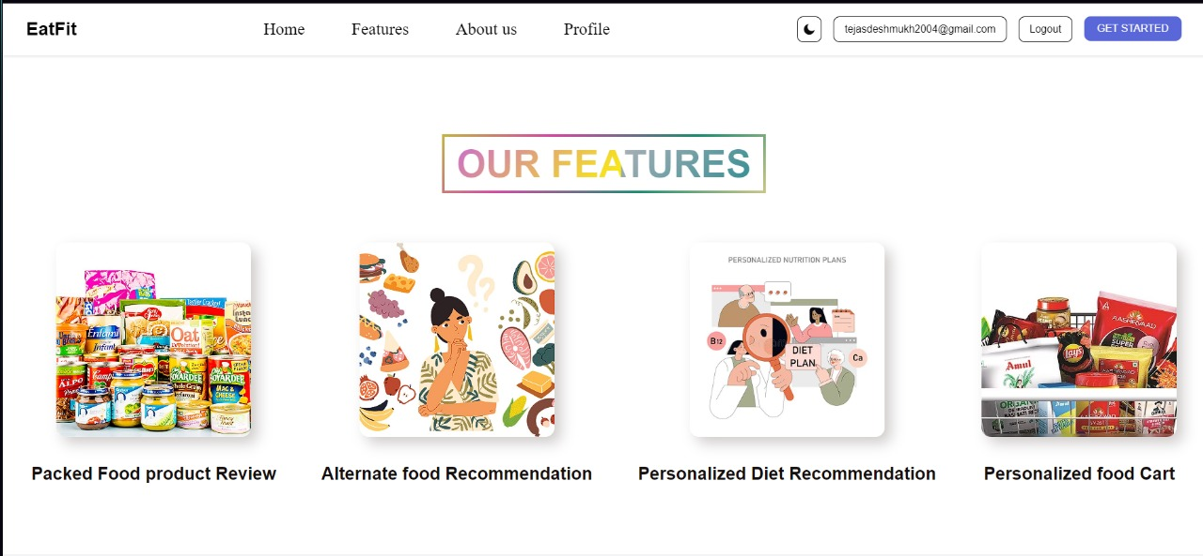
Implementation

Slide 15
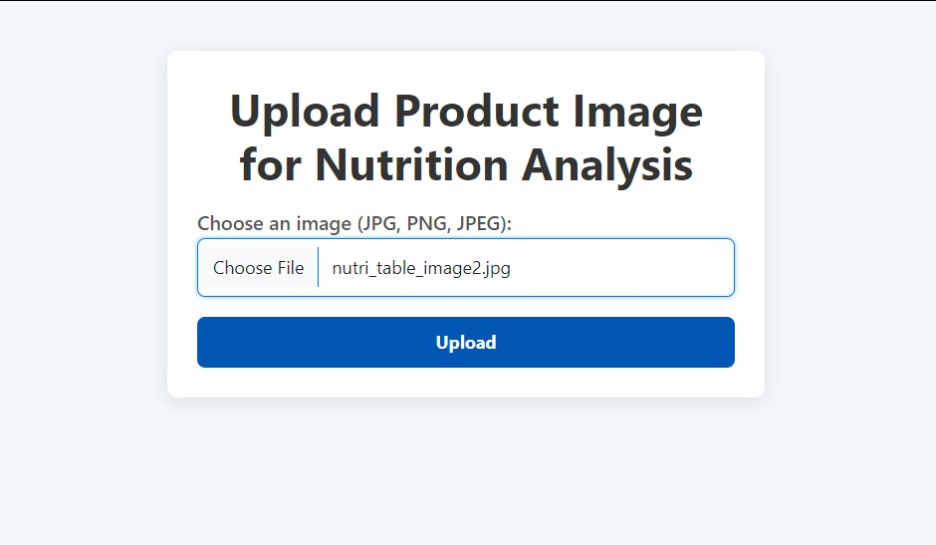
Implementation

Slide 16
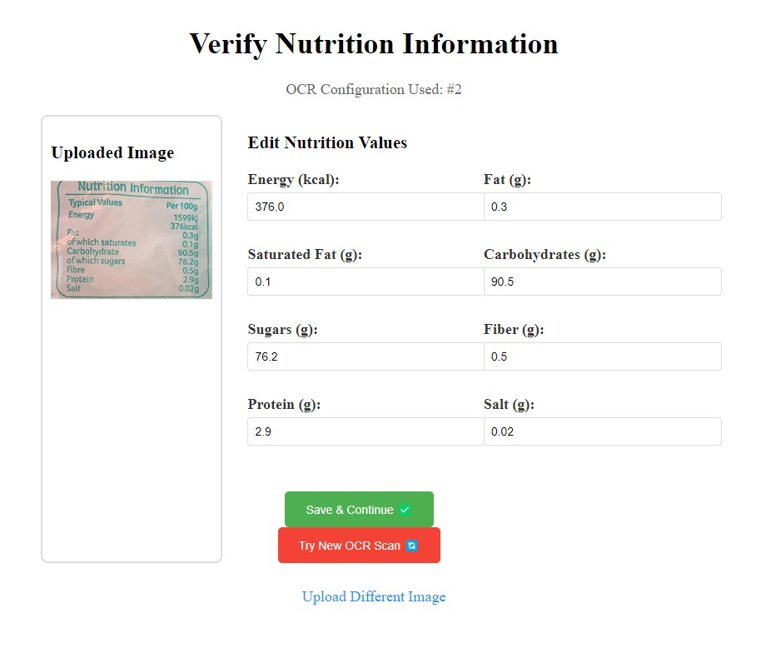
Implementation

Slide 17
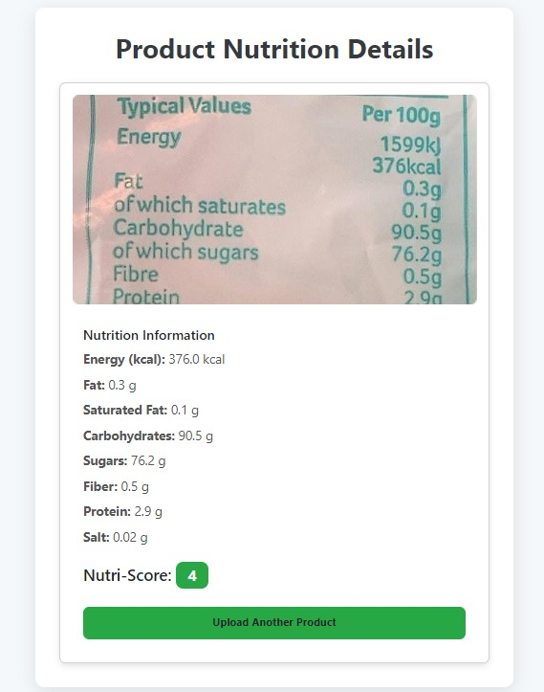
Implementation

Slide 18
Conclusion
EatFit helps users make smarter food choices by analyzing ingredients and identifying harmful components. It provides clear insights into potential health risks, ensuring safer consumption. Personalized dietary recommendations cater to individual health needs and preferences. The system eliminates the hassle of reading long ingredient lists, saving time and effort. By offering healthier alternatives, EatFit encourages better eating habits.

Slide 19
References
[1] Sambandh Bhusan Dhal, Debashish Kar ,“Leveraging AI in Food Safety,
Quality, and Security”(11 Jan 2025)
link.springer.com/article/10.1007/s42452-025-06472-w
[2] Danielle I. McCarth, “Nutritional Intelligence in the Food System: Combining
Food, Health”(27 Nov 2024)
onlinelibrary.wiley.com/doi/full/10.1111/nbu.12729
[3] Guanlan, Mavra Ahmed, Mary R. L'Abbé, “NLP and Machine Learning for
Food Categ Nutrition Prediction”(15 March 2023)
www.sciencedirect.com/science/article/pii/S0002916522105526
[4] “Food Image Recognition and Calorie Prediction" (2023)
www.irjet.net/archives/V11/i4/IRJET-V11I4304
[5] “Automated Food Prediction Using Deep Learning with Calorie Estimation”
www.irejournals.com/formatedpaper/1705602

Slide 20
Thank You...!!

